Slide 1




Dr. D. Y. Patil College of Engineering,
Akurdi, Pune
SDL Miniproject
Path Finding Visualization
A better way to visualize finding shortest paths

Slide 2

Objective
To perform the visualization of path finding using various algorithms
01
Next

Slide 3
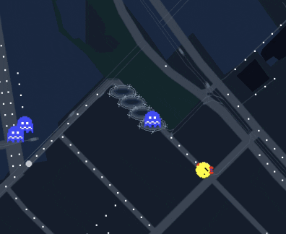
Introduction
Pathfinding Algorithms are an attempt to solve shortest path problem in Graph Theory.
Path finding algorithms are important because they are used in applications like google maps, satellite navigation systems, routing packets over the internet.
02
Next

Slide 4

OUR PROJECT VISUALIZES VARIOUS PATH-FINDING ALGORITHMS IN REAL TIME
What our Project Focuses on :
IT HAS A WELL ORGANISED GUI AND USES SOME OF THE VERY WELL KNOWN ALGORITHMS
03
Next

Slide 5
USING REACTJS AND NODE-JS
The algorithms are written in javascript and reactjs manages the whole frontend
What were the ways of fulfilling this projects needs
USING PYTHON AND DJANGO FRAMEWORK ON WEB
Algorithms are written in python and Django is used for web Integration
GRAPHICAL USER INTERFACE
GUI can be designed using python libraries such as tkinter, pyqt, pygame
04
Next

Slide 6

Tkinter
Tkinter is the standard GUI library for Python. Python when combined with Tkinter provides a fast and easy way to create GUI applications. Tkinter provides a powerful object-oriented interface to the Tk GUI toolkit.
Creating a GUI application using Tkinter is an easy task. All you need to do is perform the following steps −
Import the Tkinter module.
Create the GUI application main window.
Add one or more of the widgets to the GUI application.
Enter the main event loop to take action against each event triggered by the user.
05
Next

Slide 7

Pygame is a cross-platform set of Python modules which is used to create video games.
It consists of computer graphics and sound libraries designed to be used with the Python programming language.
Pygame was officially written by Pete Shinners to replace PySDL.
Pygame is suitable to create client-side applications that can be potentially wrapped in a standalone executable.
library
06
Next

Slide 8

What are Features of our project
A 150 x 100 grid
A start Node
End or terminating Node
Walls and Obstacles
Algorithms Like
07
Next

Slide 9
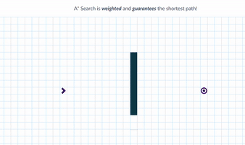
A Star
Best as it is considerable fast and optimal as it uses admissible heuristic function

Slide 10
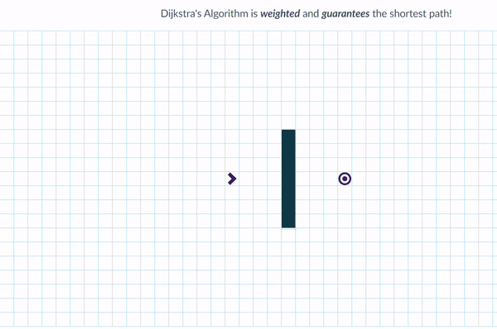
Dijkstras
Used In networking, the best way to move the packets to a node and many places

Slide 11
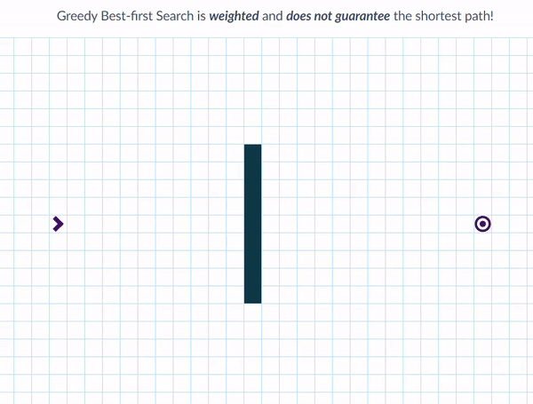
3. Greedy Best-First
It is the combination of depth-first search and breadth-first search algorithms.

Slide 12
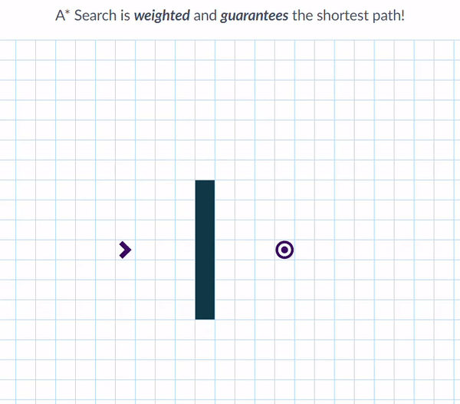
Time of execution and which algorithm might be better for your provided Condition
fig: A * vs Dijkstra
08
Next

Slide 13

S/w and H/w Requirements
Laptop / PC having windows 7 or higher/Linux/MacOS
Minimum i3 processor and 500 mb space
Python Environment
Python Libraries: Tkinter, PyGame
09
Next

Slide 14

Advantages
It is much easier to visualise the path finding using this.
Complex Maze can also be solved within seconds using this.
Disadvantages
The only disadvantage at this moment is it requires python and some dependencies as it is GUI based but can be overlooked in future
10
Next

Slide 15

Future Scope
More algorithms and more features could be added to it.
It can be implemented on web platform and hosted on web so it can be accessed from any device.
11
Next

Slide 16


Quote
It's the journey rather than the destination,
which makes the travel interesting.

Slide 17

Presented By:
Karan Gandhi
Hitesh Kowdiki
Sanket Mense

